Slide 1
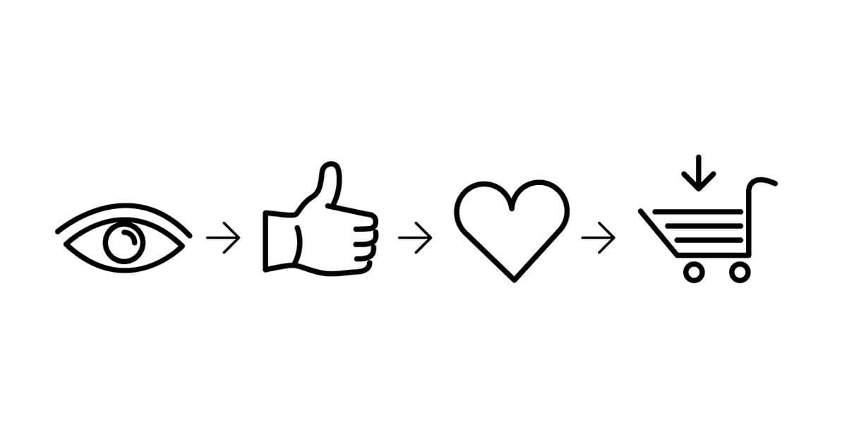
DAGMAR APPROACH
Abhijeet Singh

Slide 2
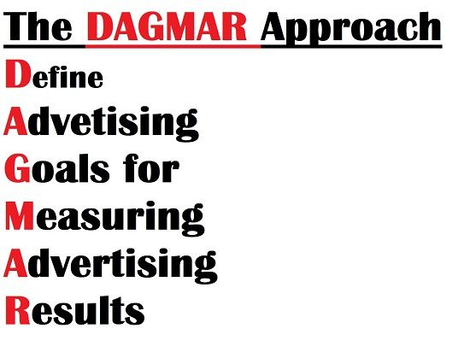
It is a marketing tool to compute the results of an advertising campaign. DAGMAR attempts to guide customers through ACCA model.

Slide 3
HISTORY
DAGMAR is an advertising model proposed by Russell Colley in 1961. Russell Colley advocated that effective advertising seeks to communicate rather than to sell.
Advertisers discover whether their message conveyed enough information and understanding of a product to their consumers and also its respective benefits from clear objectives.

Slide 4
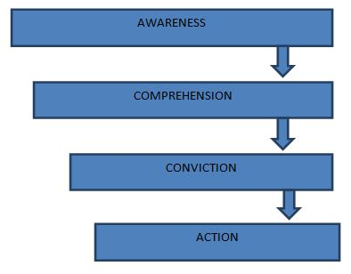
ACCA Model

Slide 5

AWARENESS
Awareness of the existence of a product or a service is needful before the purchase behaviour is expected.
The fundamental task of advertising activity is to improve the consumer awareness of the product.
Once the consumer awareness has been provided to the target audience, it should not be forsaken. The target audience tends to get distracted by other competing messages if they are ignored.
Awareness has to be created, developed, refined and maintained according to the characteristics of the market and the scenario of the organization at any given point of time.
The objective is to create awareness about the product amongst the target audience.

Slide 6

2. COMPREHENSION
Awareness on its own is not sufficient to stimulate a purchase. Information and understanding about the product and the organization are essential.
This can be achieved by providing information about the brand features.
Example: Google Map
The objective is to provide all the information about the product.

Slide 7
3. CONVICTION
Conviction is developing a mental disposition in the consumer to buy the product.
At this stage, a sense of conviction is established, and by creating interests and preferences, customers are convinced that a certain product should be tried at the next purchase.
At this step, the job of the advertising activity is to mould the audience’s beliefs and persuade them to buy it.
This is often achieved through messages that convey the superiority of the products over the others by flaunting the rewards or incentives for using the product.
Example- Dr. Fix it.
The objective is to create a positive mental disposition to buy a product.
4. ACTION
This is the final step which involves the final purchase of the product. The objective is to motivate the customer to buy the product.

Slide 8

Conviction

Slide 9
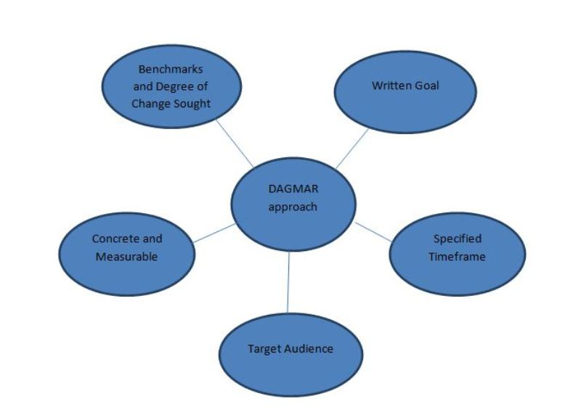
A major contribution of Colley’s DAGMAR approach was a specification of what constitutes a good objective.

Slide 10
Charachteristics of DAGMAR
TARGET AUDIENCE
DAGMAR claims the target audience should be well defined.
Target markets can be segmented into Primary and secondary groups.
Primary markets are the main target audience, on whom the marketing efforts are mainly focused.
Secondary markets are the target audience on whom the marketing efforts will focus after the primary market goals are achieved. After identifying the target audience, the organization devises objectives for advertising and later the objectives for communication.
Notes:
A group of potential customers, who have the highest likelihood of purchasing the product, is the target market. Identifying the target market includes the process of demographic, geographic, and psychological segmentation.

Slide 11
CONCRETE AND MEASURABLE
The objective of communication should be a precise and clear statement of whatever message the advertiser wants to communicate to the target audience.
The specification must include all the details and descriptions of the measurement procedure.
Ex- To boost/enhance the sales by 50%.

Slide 12
SPECIFIED TIMEFRAME AND BENCHMARKS
A good objective has a specified time frame, during which the objective is to be achieved. Understanding the specifications enables advertisers to define goals that will yield the best result.
Setting a specific timeframe assures effective evaluation of results. The timeframe should be realistic to prohibit skewed results from static marketing.
Creating the benchmark is essential for an appropriate measurement of the effectiveness of the advertisement.
Ex- to boost/enhance the sales by 50% in next 2 months

Slide 13
WRITTEN GOAL
The goal should be committed on a paper.
When the goals are clearly written, basic shortfalls and flaws are exposed, it becomes eventually easy to determine whether the goal contains the crucial aspects of the DAGMAR approach.

Slide 14
OBJECTIVES OF DAGMAR APPROACH
Persuade a prospect to visit the showroom.
Growth in market share.
Improve sales turnover.
Perform complete selling function.
Advertise a special reason to buy.
Stimulate impulse sales.
Remind people to buy.
Create awareness about the product and brand existence.
Create favourable emotional disposition towards the product.
Impart information regarding benefits and distinctive features of the product.
Combat and offset competitive claims.
Correct false impressions, wrong information and other hindrances to sales.
Aid sales force with sales promotion and selling activities and boost their morale.
Establish brand recognition and acceptance.

Slide 15
EXAMPLE

